Slide 1
See top right of each slide, they are numbered and grouped.

Slide 2

1

Slide 3
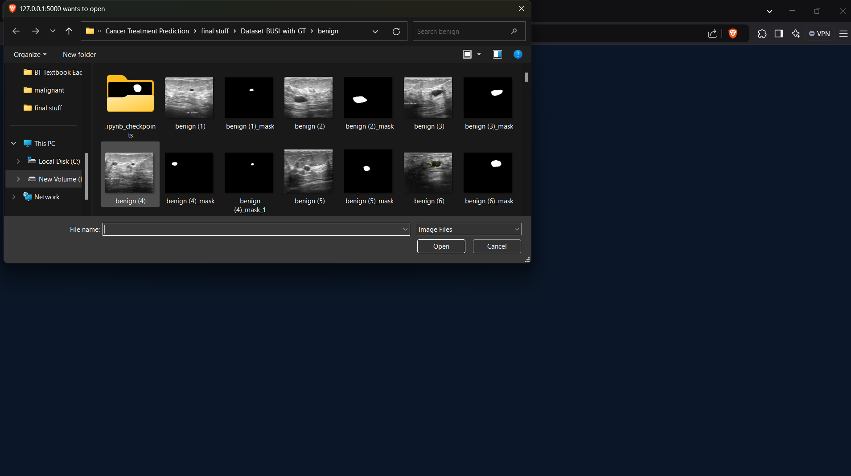
2

Slide 4

3

Slide 5

4

Slide 6
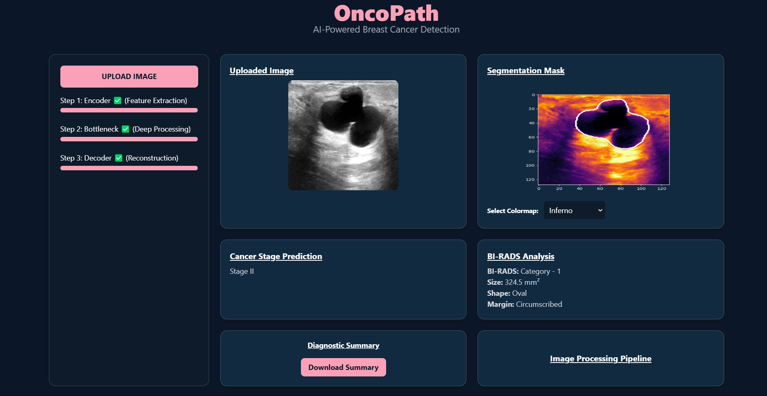
5

Slide 7
6

Slide 8
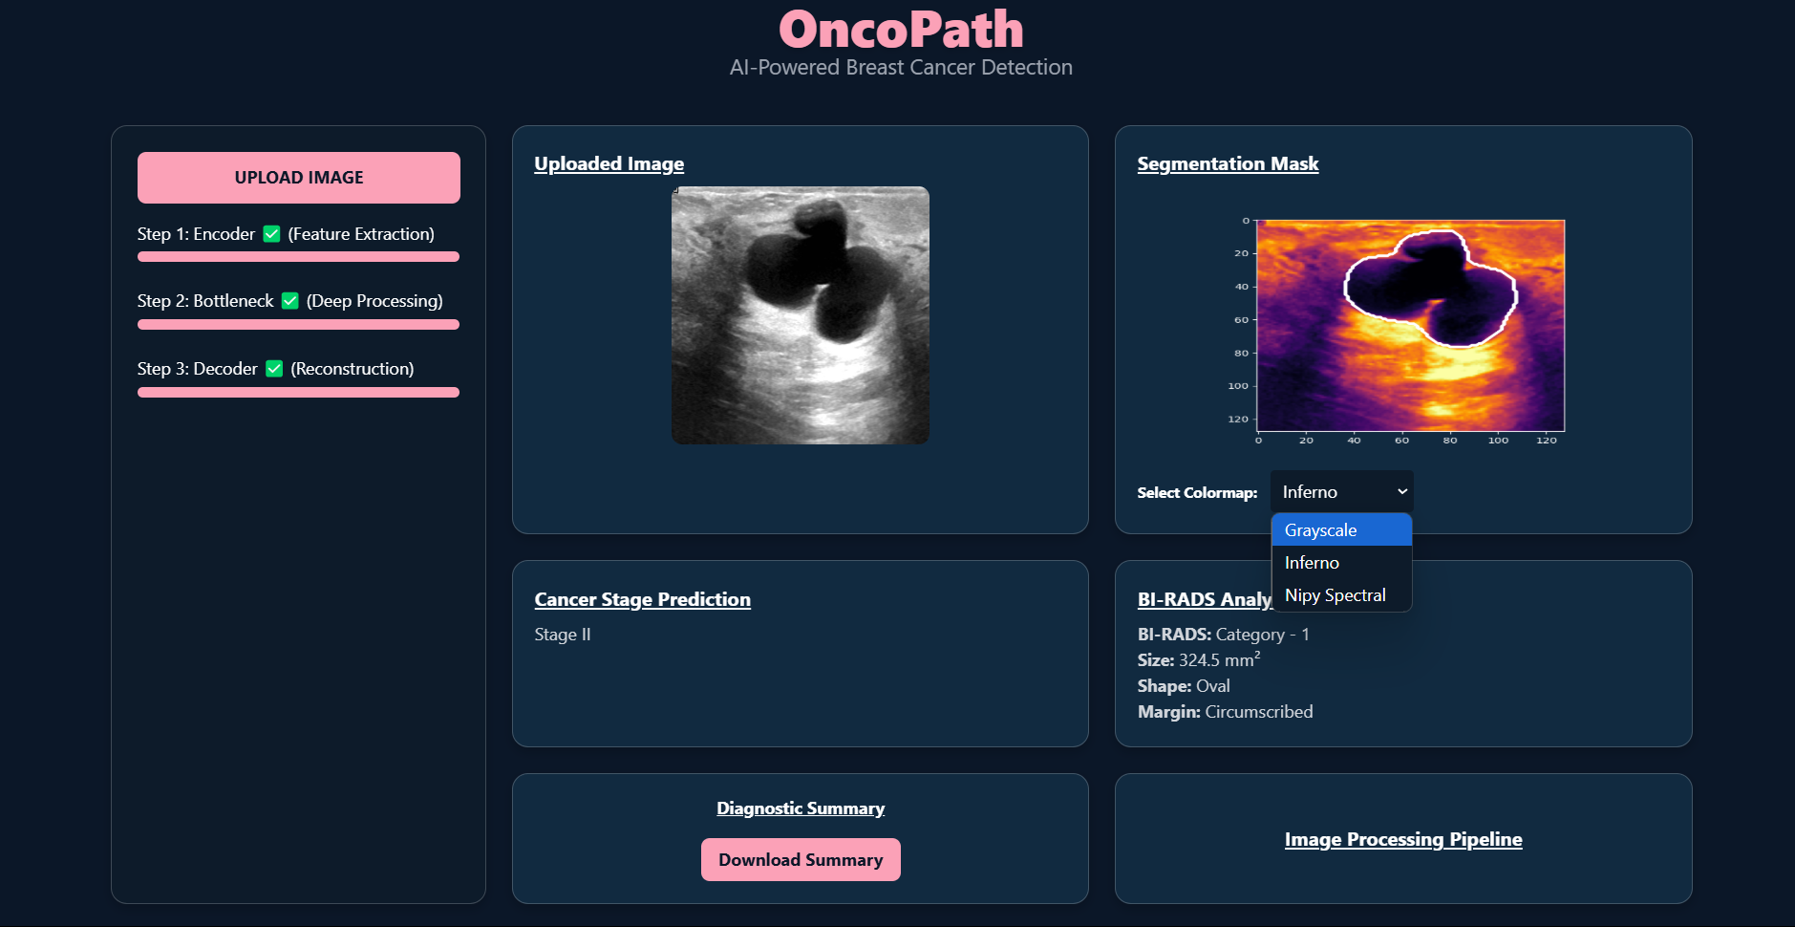
6.1

Slide 9
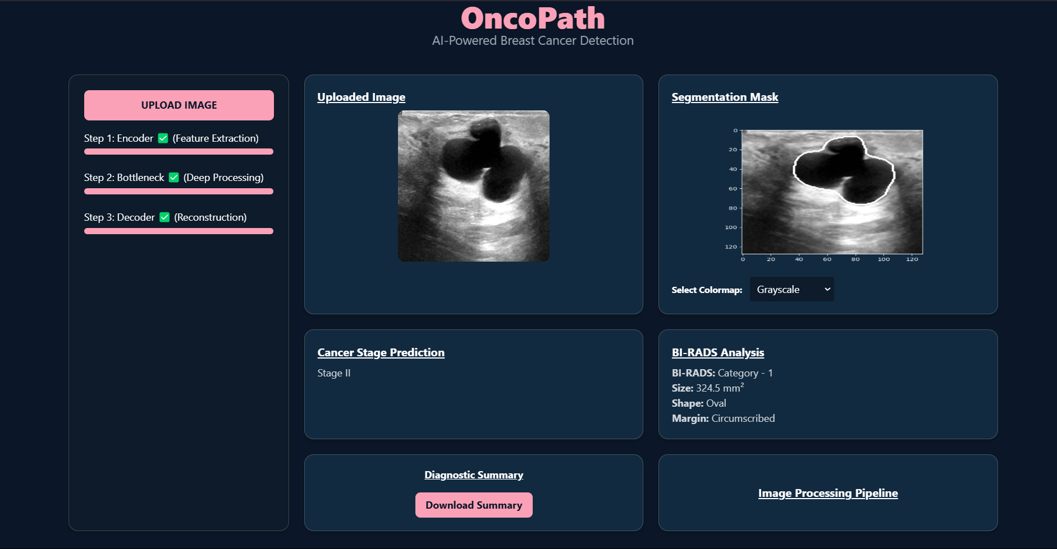
6.2

Slide 10
7

Slide 11
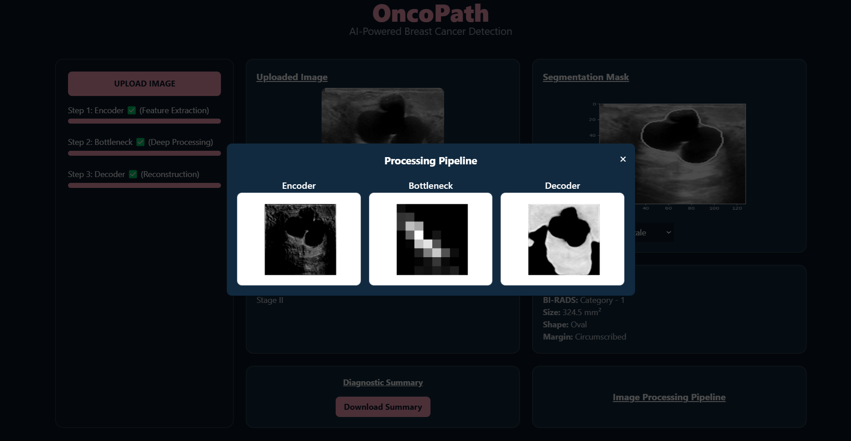
7.1

Slide 12
8

Slide 13
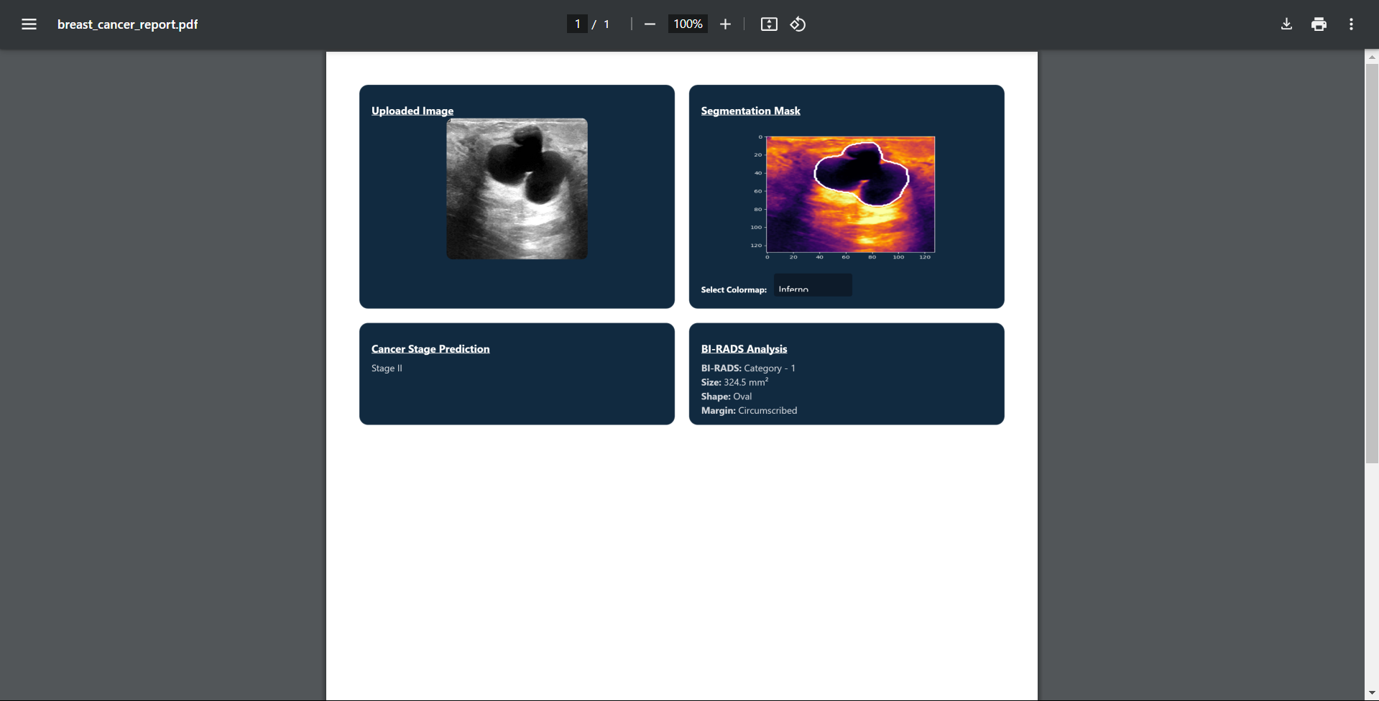
8.1

